Slide 1



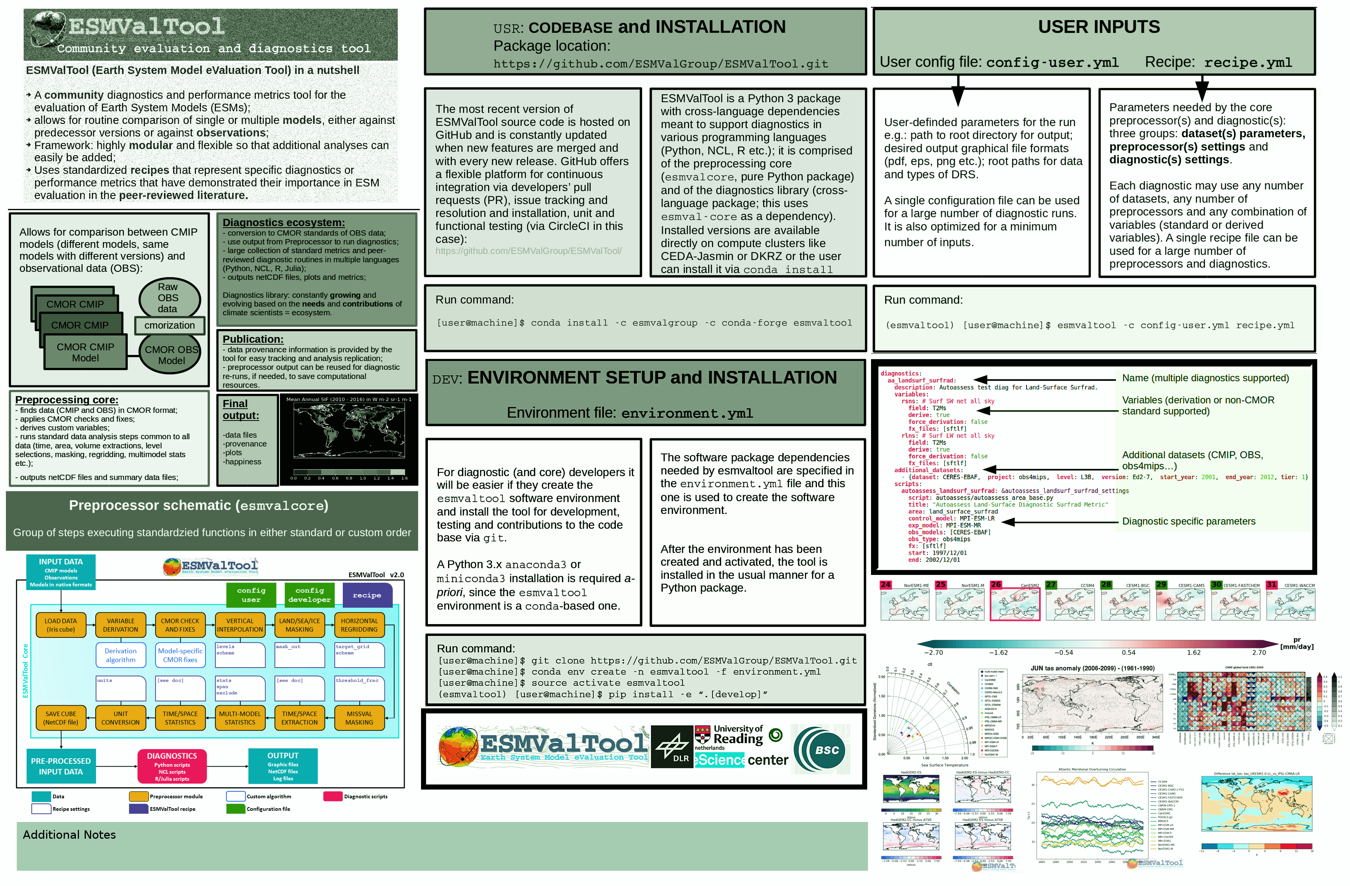
ESMValTool
A powerful, community-driven diagnostics and evaluation tool for Earth System Models
Valeriu Predoi for the ESMValTool core development team
Author Name, Author Name, Author Name, Author Name, Author Name, Author Name
University of Leeds, University of Leeds, University of Leeds, University of Leeds, University of Leeds, University of Leeds

